Slide 1
SEQUENTIAL CIRCUIT DESIGN
3 BIT COUNTER using D AND JK Flip Flop
LECTURE 9

Slide 2
STEPS FOR SEQUENTIAL CIRCUIT DESIGN
State Diagram
Next State Table
State Reduction And Assignment
Flip Flop Transition Table (FLIP FLOP Selection)
Simplification
Input/output Equations
Implementations of Equation(Logic Diagram)

Slide 3
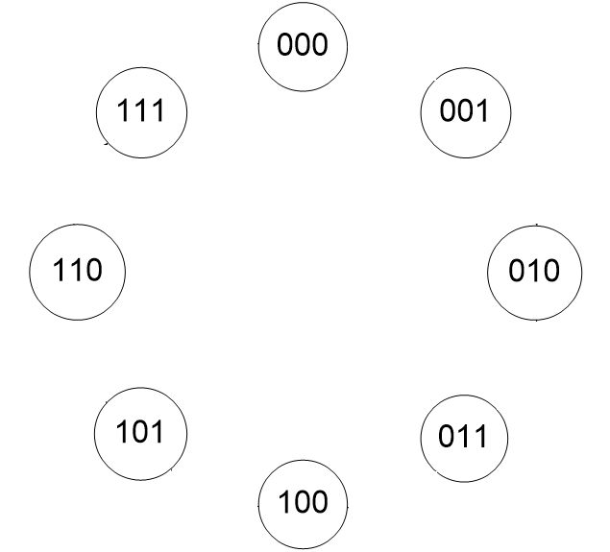
STATE DIAGRAM

Slide 4
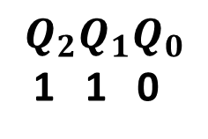
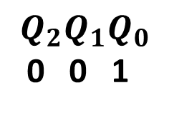
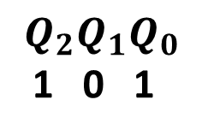
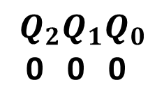
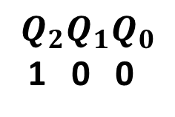
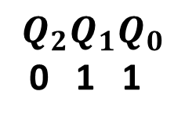
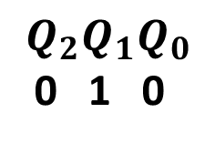
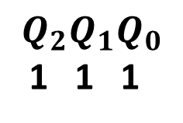
STATE DIAGRAM
$$Q_{2}Q_{1}Q_{0}$$
0 0 0
$$Q_{2}Q_{1}Q_{0}$$
1 1 1
$$Q_{2}Q_{1}Q_{0}$$
0 0 1
$$Q_{2}Q_{1}Q_{0}$$
1 1 0
$$Q_{2}Q_{1}Q_{0}$$
0 1 0
$$Q_{2}Q_{1}Q_{0}$$
1 0 1
$$Q_{2}Q_{1}Q_{0}$$
0 1 1
$$Q_{2}Q_{1}Q_{0}$$
1 0 0

Slide 5
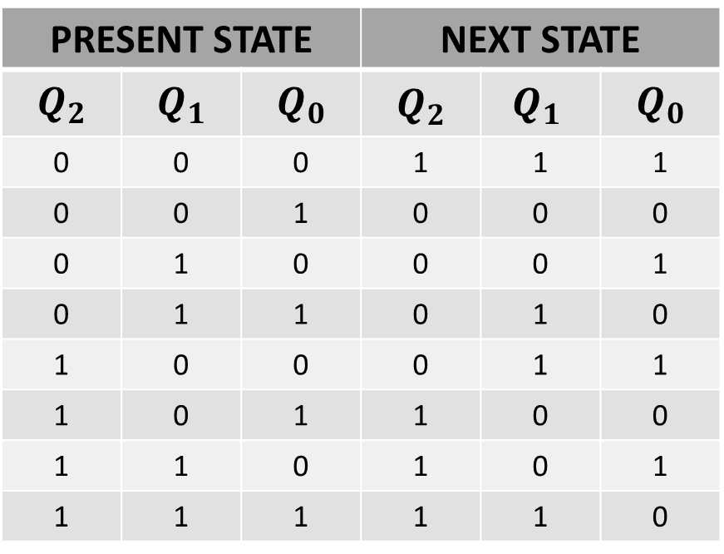
NEXT STATE TABLE
PRESENT STATE |  |  | NEXT STATE
$$Q_{2}$$ | $$Q_{1}$$ | $$Q_{0}$$ | $$Q_{2}$$ | $${Q_{1}}_{ }$$ | $$Q_{0}$$
0 | 0 | 0 | 1 | 1 | 1
0 | 0 | 1 | 0 | 0 | 0
0 | 1 | 0 | 0 | 0 | 1
0 | 1 | 1 | 0 | 1 | 0
1 | 0 | 0 | 0 | 1 | 1
1 | 0 | 1 | 1 | 0 | 0
1 | 1 | 0 | 1 | 0 | 1
1 | 1 | 1 | 1 | 1 | 0

Slide 6
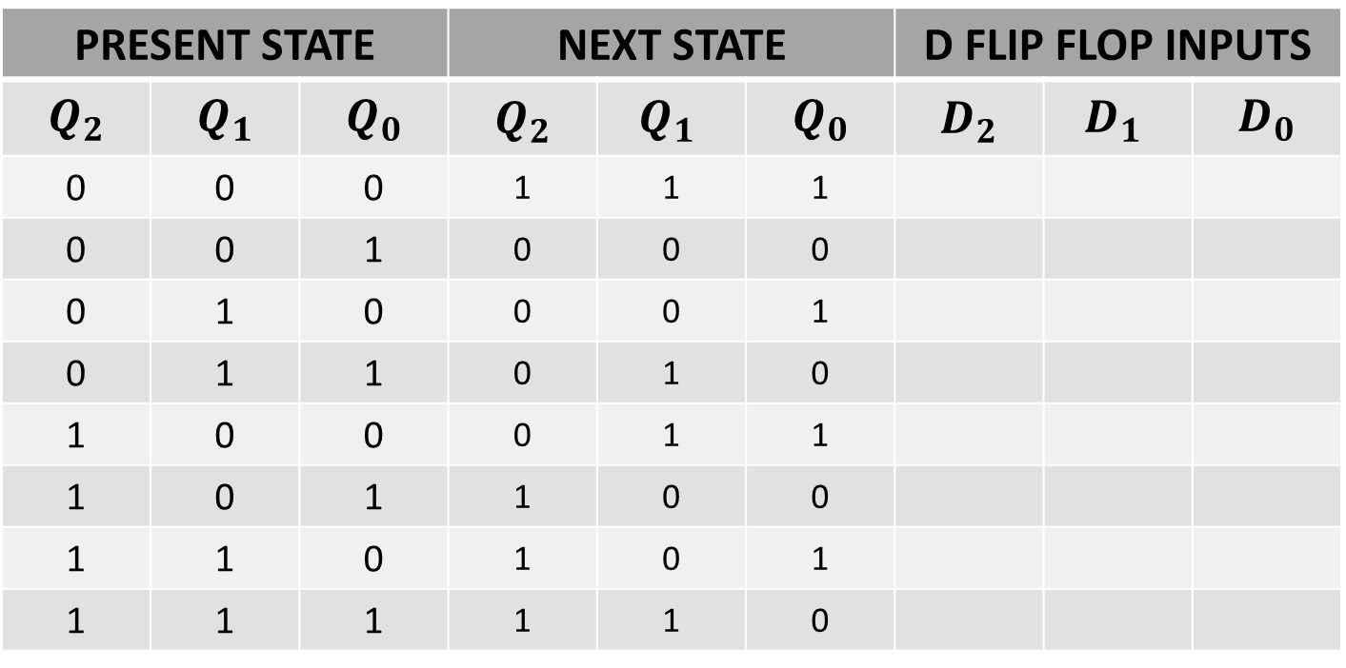
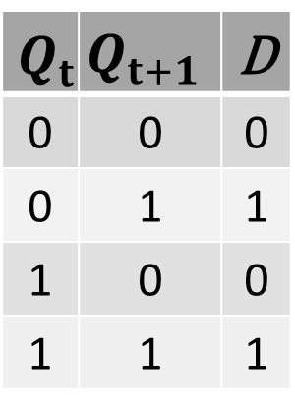
NEXT STATE TABLE USING D FLIP FLOP
$$Q_{t}$$ | $$Q_{t+1}$$ | D
0 | 0 | 0
0 | 1 | 1
1 | 0 | 0
1 | 1 | 1
PRESENT STATE |  |  | NEXT STATE |  |  | D FLIP FLOP INPUTS
$$Q_{2}$$ | $$Q_{1}$$ | $$Q_{0}$$ | $$Q_{2}$$ | $${Q_{1}}_{ }$$ | $$Q_{0}$$ | $$D_{2}$$ | $${D_{1}}_{ }$$ | $$D_{0}$$
0 | 0 | 0 | 1 | 1 | 1
0 | 0 | 1 | 0 | 0 | 0
0 | 1 | 0 | 0 | 0 | 1
0 | 1 | 1 | 0 | 1 | 0
1 | 0 | 0 | 0 | 1 | 1
1 | 0 | 1 | 1 | 0 | 0
1 | 1 | 0 | 1 | 0 | 1
1 | 1 | 1 | 1 | 1 | 0

Slide 7
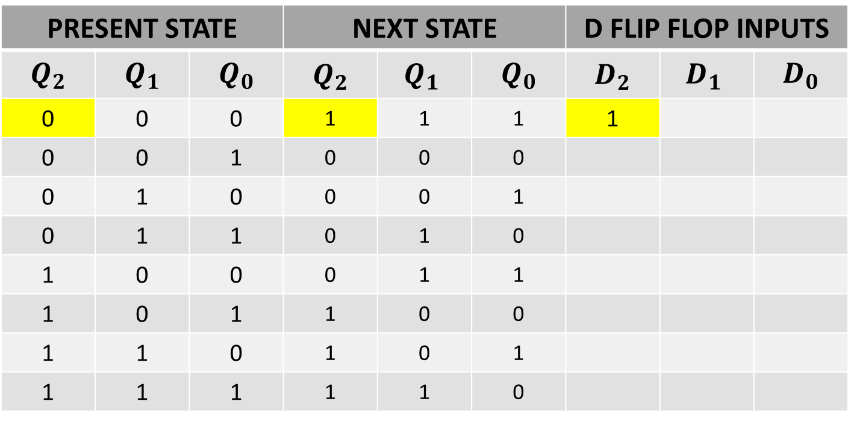
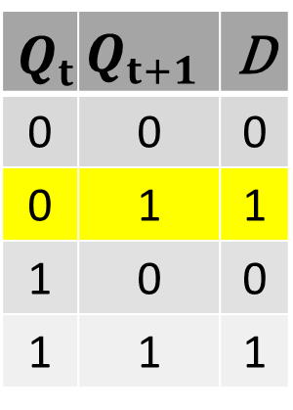
NEXT STATE TABLE USING D FLIP FLOP
$$Q_{t}$$ | $$Q_{t+1}$$ | D
0 | 0 | 0
0 | 1 | 1
1 | 0 | 0
1 | 1 | 1
PRESENT STATE |  |  | NEXT STATE |  |  | D FLIP FLOP INPUTS
$$Q_{2}$$ | $$Q_{1}$$ | $$Q_{0}$$ | $$Q_{2}$$ | $${Q_{1}}_{ }$$ | $$Q_{0}$$ | $$D_{2}$$ | $${D_{1}}_{ }$$ | $$D_{0}$$
0 | 0 | 0 | 1 | 1 | 1 | 1
0 | 0 | 1 | 0 | 0 | 0
0 | 1 | 0 | 0 | 0 | 1
0 | 1 | 1 | 0 | 1 | 0
1 | 0 | 0 | 0 | 1 | 1
1 | 0 | 1 | 1 | 0 | 0
1 | 1 | 0 | 1 | 0 | 1
1 | 1 | 1 | 1 | 1 | 0

Slide 8
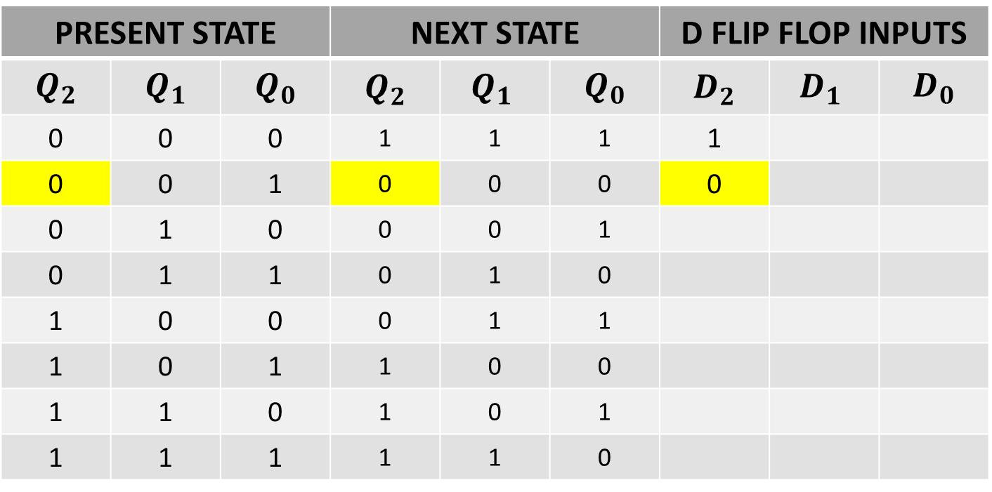
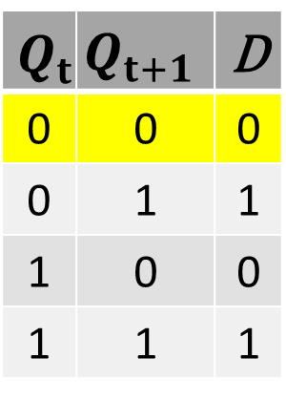
NEXT STATE TABLE USING D FLIP FLOP
$$Q_{t}$$ | $$Q_{t+1}$$ | D
0 | 0 | 0
0 | 1 | 1
1 | 0 | 0
1 | 1 | 1
PRESENT STATE |  |  | NEXT STATE |  |  | D FLIP FLOP INPUTS
$$Q_{2}$$ | $$Q_{1}$$ | $$Q_{0}$$ | $$Q_{2}$$ | $${Q_{1}}_{ }$$ | $$Q_{0}$$ | $$D_{2}$$ | $${D_{1}}_{ }$$ | $$D_{0}$$
0 | 0 | 0 | 1 | 1 | 1 | 1
0 | 0 | 1 | 0 | 0 | 0 | 0
0 | 1 | 0 | 0 | 0 | 1
0 | 1 | 1 | 0 | 1 | 0
1 | 0 | 0 | 0 | 1 | 1
1 | 0 | 1 | 1 | 0 | 0
1 | 1 | 0 | 1 | 0 | 1
1 | 1 | 1 | 1 | 1 | 0

Slide 9
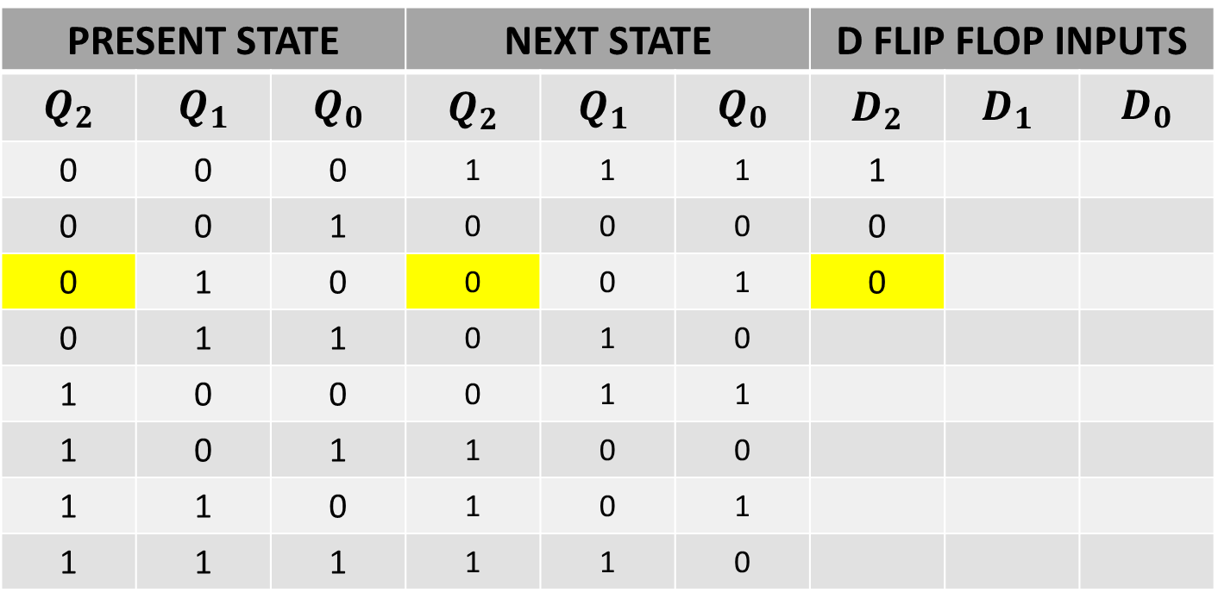
NEXT STATE TABLE USING D FLIP FLOP
$$Q_{t}$$ | $$Q_{t+1}$$ | D
0 | 0 | 0
0 | 1 | 1
1 | 0 | 0
1 | 1 | 1
PRESENT STATE |  |  | NEXT STATE |  |  | D FLIP FLOP INPUTS
$$Q_{2}$$ | $$Q_{1}$$ | $$Q_{0}$$ | $$Q_{2}$$ | $${Q_{1}}_{ }$$ | $$Q_{0}$$ | $$D_{2}$$ | $${D_{1}}_{ }$$ | $$D_{0}$$
0 | 0 | 0 | 1 | 1 | 1 | 1
0 | 0 | 1 | 0 | 0 | 0 | 0
0 | 1 | 0 | 0 | 0 | 1 | 0
0 | 1 | 1 | 0 | 1 | 0
1 | 0 | 0 | 0 | 1 | 1
1 | 0 | 1 | 1 | 0 | 0
1 | 1 | 0 | 1 | 0 | 1
1 | 1 | 1 | 1 | 1 | 0

Slide 10
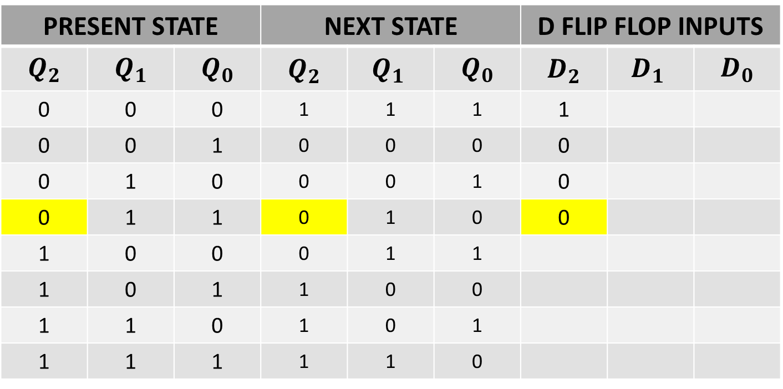

NEXT STATE TABLE USING D FLIP FLOP
$$Q_{t}$$ | $$Q_{t+1}$$ | D
0 | 0 | 0
0 | 1 | 1
1 | 0 | 0
1 | 1 | 1
PRESENT STATE |  |  | NEXT STATE |  |  | D FLIP FLOP INPUTS
$$Q_{2}$$ | $$Q_{1}$$ | $$Q_{0}$$ | $$Q_{2}$$ | $${Q_{1}}_{ }$$ | $$Q_{0}$$ | $$D_{2}$$ | $${D_{1}}_{ }$$ | $$D_{0}$$
0 | 0 | 0 | 1 | 1 | 1 | 1
0 | 0 | 1 | 0 | 0 | 0 | 0
0 | 1 | 0 | 0 | 0 | 1 | 0
0 | 1 | 1 | 0 | 1 | 0 | 0
1 | 0 | 0 | 0 | 1 | 1
1 | 0 | 1 | 1 | 0 | 0
1 | 1 | 0 | 1 | 0 | 1
1 | 1 | 1 | 1 | 1 | 0

Slide 11
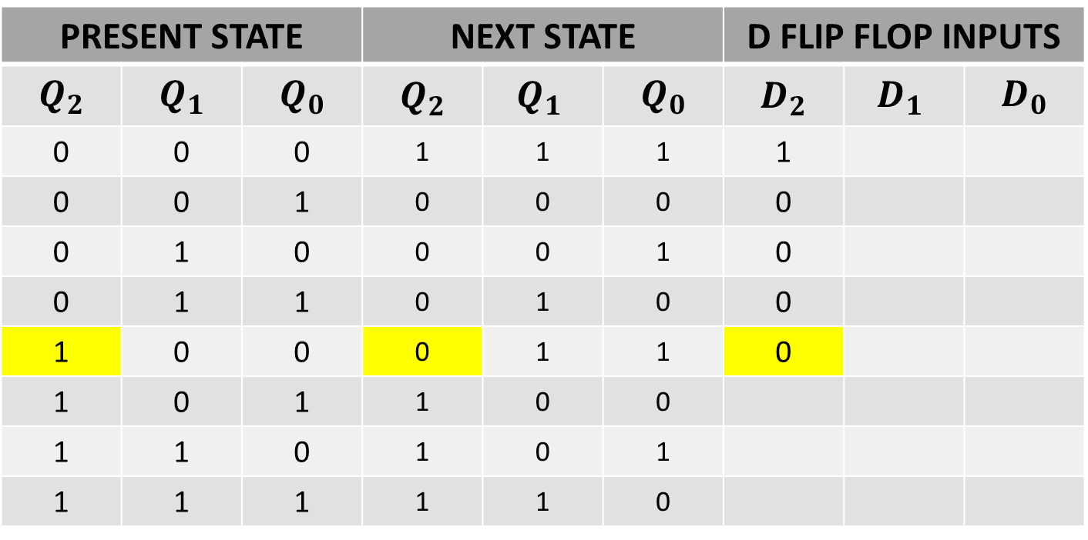
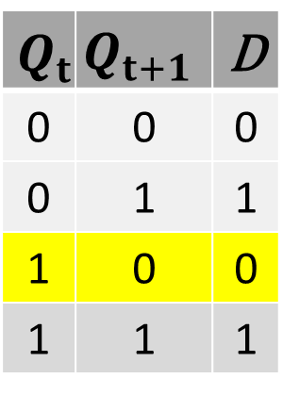
NEXT STATE TABLE USING D FLIP FLOP
$$Q_{t}$$ | $$Q_{t+1}$$ | D
0 | 0 | 0
0 | 1 | 1
1 | 0 | 0
1 | 1 | 1
PRESENT STATE |  |  | NEXT STATE |  |  | D FLIP FLOP INPUTS
$$Q_{2}$$ | $$Q_{1}$$ | $$Q_{0}$$ | $$Q_{2}$$ | $${Q_{1}}_{ }$$ | $$Q_{0}$$ | $$D_{2}$$ | $${D_{1}}_{ }$$ | $$D_{0}$$
0 | 0 | 0 | 1 | 1 | 1 | 1
0 | 0 | 1 | 0 | 0 | 0 | 0
0 | 1 | 0 | 0 | 0 | 1 | 0
0 | 1 | 1 | 0 | 1 | 0 | 0
1 | 0 | 0 | 0 | 1 | 1 | 0
1 | 0 | 1 | 1 | 0 | 0
1 | 1 | 0 | 1 | 0 | 1
1 | 1 | 1 | 1 | 1 | 0

Slide 12
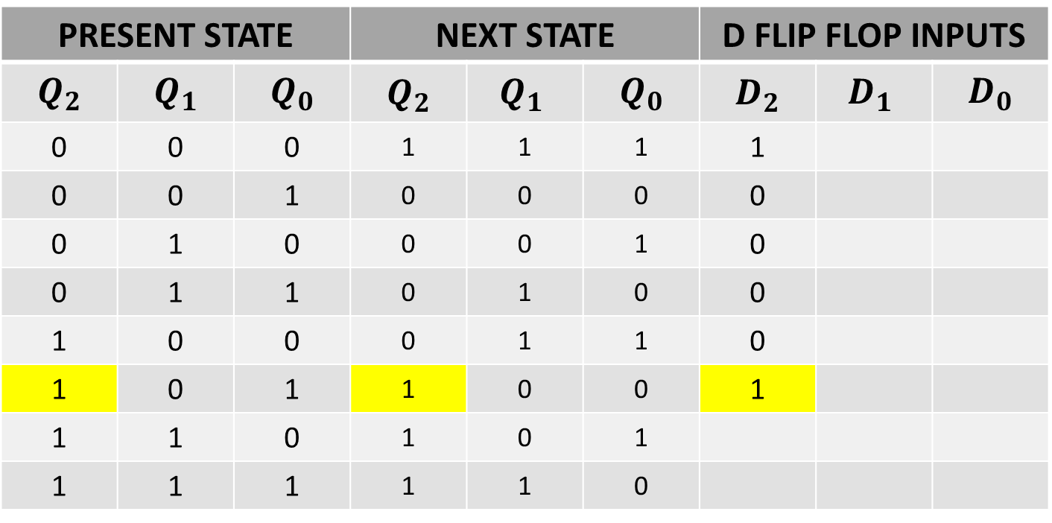
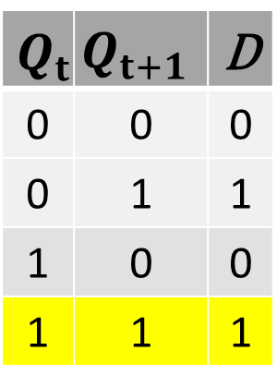
NEXT STATE TABLE USING D FLIP FLOP
$$Q_{t}$$ | $$Q_{t+1}$$ | D
0 | 0 | 0
0 | 1 | 1
1 | 0 | 0
1 | 1 | 1
PRESENT STATE |  |  | NEXT STATE |  |  | D FLIP FLOP INPUTS
$$Q_{2}$$ | $$Q_{1}$$ | $$Q_{0}$$ | $$Q_{2}$$ | $${Q_{1}}_{ }$$ | $$Q_{0}$$ | $$D_{2}$$ | $${D_{1}}_{ }$$ | $$D_{0}$$
0 | 0 | 0 | 1 | 1 | 1 | 1
0 | 0 | 1 | 0 | 0 | 0 | 0
0 | 1 | 0 | 0 | 0 | 1 | 0
0 | 1 | 1 | 0 | 1 | 0 | 0
1 | 0 | 0 | 0 | 1 | 1 | 0
1 | 0 | 1 | 1 | 0 | 0 | 1
1 | 1 | 0 | 1 | 0 | 1
1 | 1 | 1 | 1 | 1 | 0

Slide 13
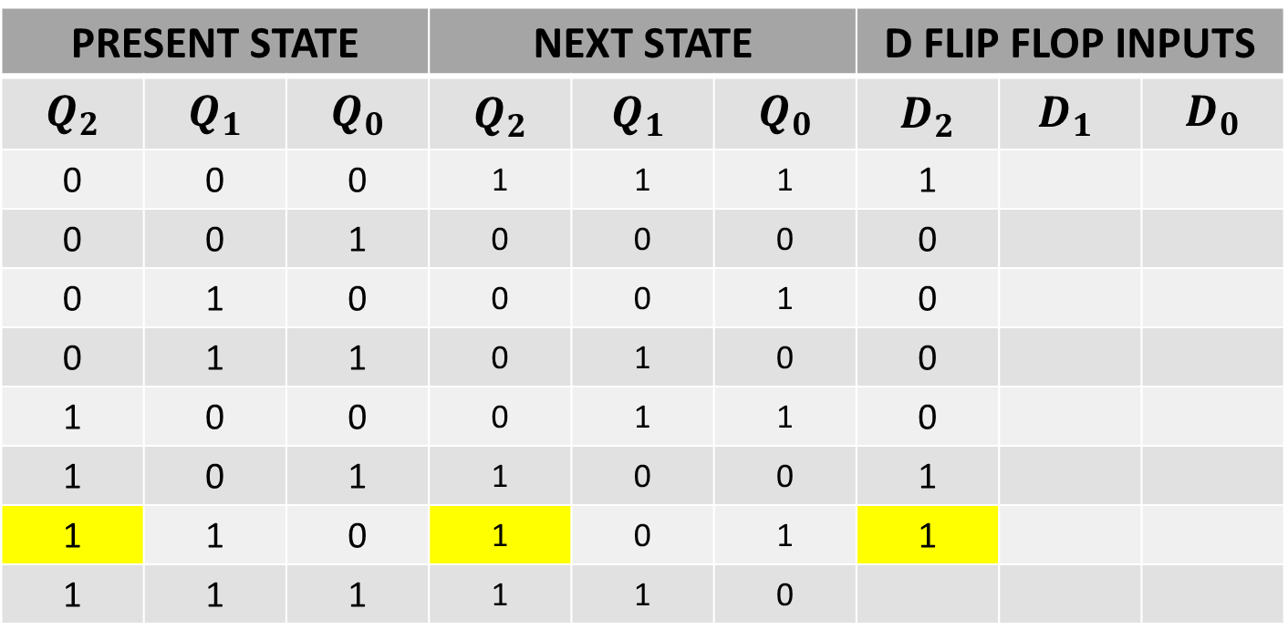
NEXT STATE TABLE USING D FLIP FLOP
$$Q_{t}$$ | $$Q_{t+1}$$ | D
0 | 0 | 0
0 | 1 | 1
1 | 0 | 0
1 | 1 | 1
PRESENT STATE |  |  | NEXT STATE |  |  | D FLIP FLOP INPUTS
$$Q_{2}$$ | $$Q_{1}$$ | $$Q_{0}$$ | $$Q_{2}$$ | $${Q_{1}}_{ }$$ | $$Q_{0}$$ | $$D_{2}$$ | $${D_{1}}_{ }$$ | $$D_{0}$$
0 | 0 | 0 | 1 | 1 | 1 | 1
0 | 0 | 1 | 0 | 0 | 0 | 0
0 | 1 | 0 | 0 | 0 | 1 | 0
0 | 1 | 1 | 0 | 1 | 0 | 0
1 | 0 | 0 | 0 | 1 | 1 | 0
1 | 0 | 1 | 1 | 0 | 0 | 1
1 | 1 | 0 | 1 | 0 | 1 | 1
1 | 1 | 1 | 1 | 1 | 0

Slide 14
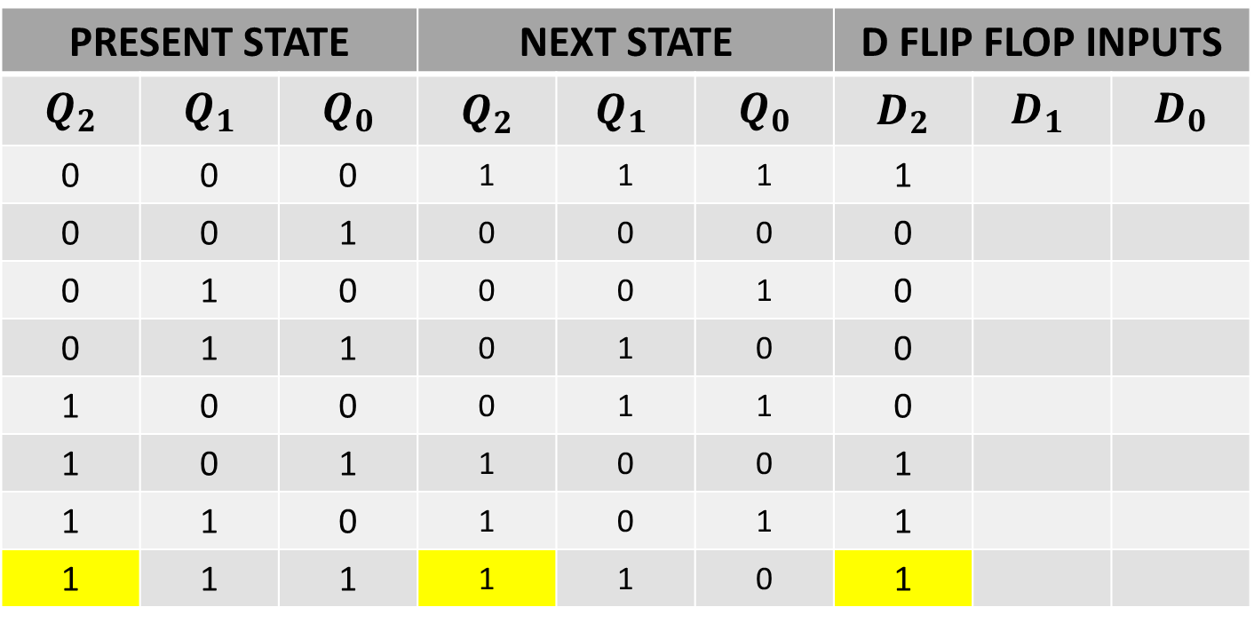
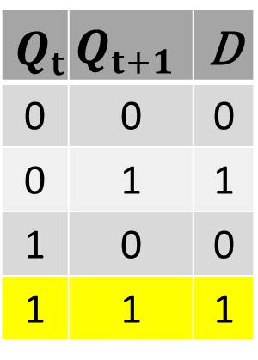
NEXT STATE TABLE USING D FLIP FLOP
$$Q_{t}$$ | $$Q_{t+1}$$ | D
0 | 0 | 0
0 | 1 | 1
1 | 0 | 0
1 | 1 | 1
PRESENT STATE |  |  | NEXT STATE |  |  | D FLIP FLOP INPUTS
$$Q_{2}$$ | $$Q_{1}$$ | $$Q_{0}$$ | $$Q_{2}$$ | $${Q_{1}}_{ }$$ | $$Q_{0}$$ | $$D_{2}$$ | $${D_{1}}_{ }$$ | $$D_{0}$$
0 | 0 | 0 | 1 | 1 | 1 | 1
0 | 0 | 1 | 0 | 0 | 0 | 0
0 | 1 | 0 | 0 | 0 | 1 | 0
0 | 1 | 1 | 0 | 1 | 0 | 0
1 | 0 | 0 | 0 | 1 | 1 | 0
1 | 0 | 1 | 1 | 0 | 0 | 1
1 | 1 | 0 | 1 | 0 | 1 | 1
1 | 1 | 1 | 1 | 1 | 0 | 1

Slide 15
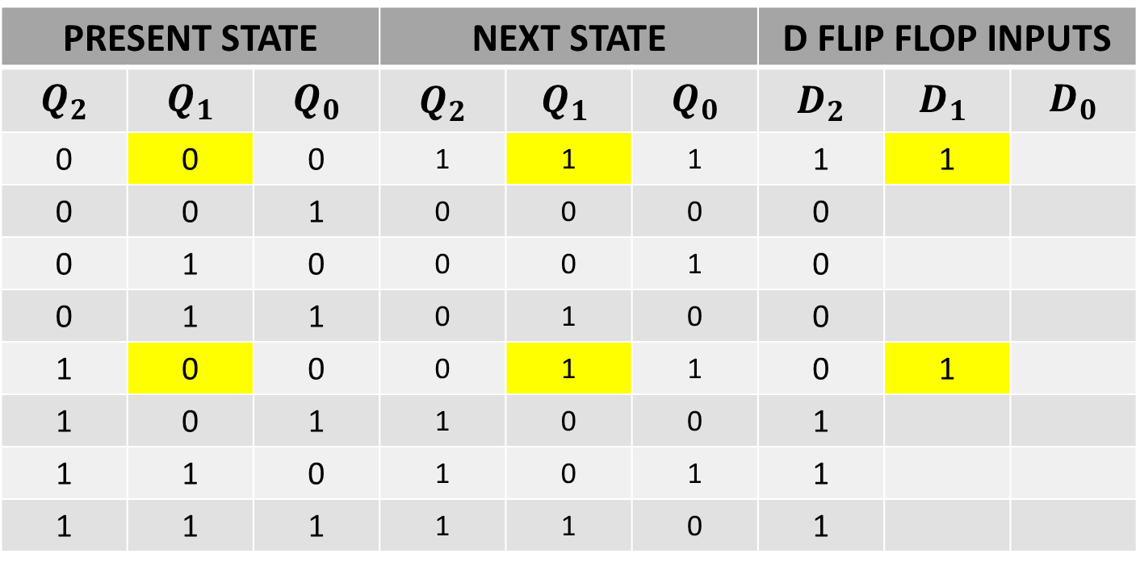
NEXT STATE TABLE USING D FLIP FLOP
$$Q_{t}$$ | $$Q_{t+1}$$ | D
0 | 0 | 0
0 | 1 | 1
1 | 0 | 0
1 | 1 | 1
PRESENT STATE |  |  | NEXT STATE |  |  | D FLIP FLOP INPUTS
$$Q_{2}$$ | $$Q_{1}$$ | $$Q_{0}$$ | $$Q_{2}$$ | $${Q_{1}}_{ }$$ | $$Q_{0}$$ | $$D_{2}$$ | $${D_{1}}_{ }$$ | $$D_{0}$$
0 | 0 | 0 | 1 | 1 | 1 | 1 | 1
0 | 0 | 1 | 0 | 0 | 0 | 0
0 | 1 | 0 | 0 | 0 | 1 | 0
0 | 1 | 1 | 0 | 1 | 0 | 0
1 | 0 | 0 | 0 | 1 | 1 | 0 | 1
1 | 0 | 1 | 1 | 0 | 0 | 1
1 | 1 | 0 | 1 | 0 | 1 | 1
1 | 1 | 1 | 1 | 1 | 0 | 1

Slide 16
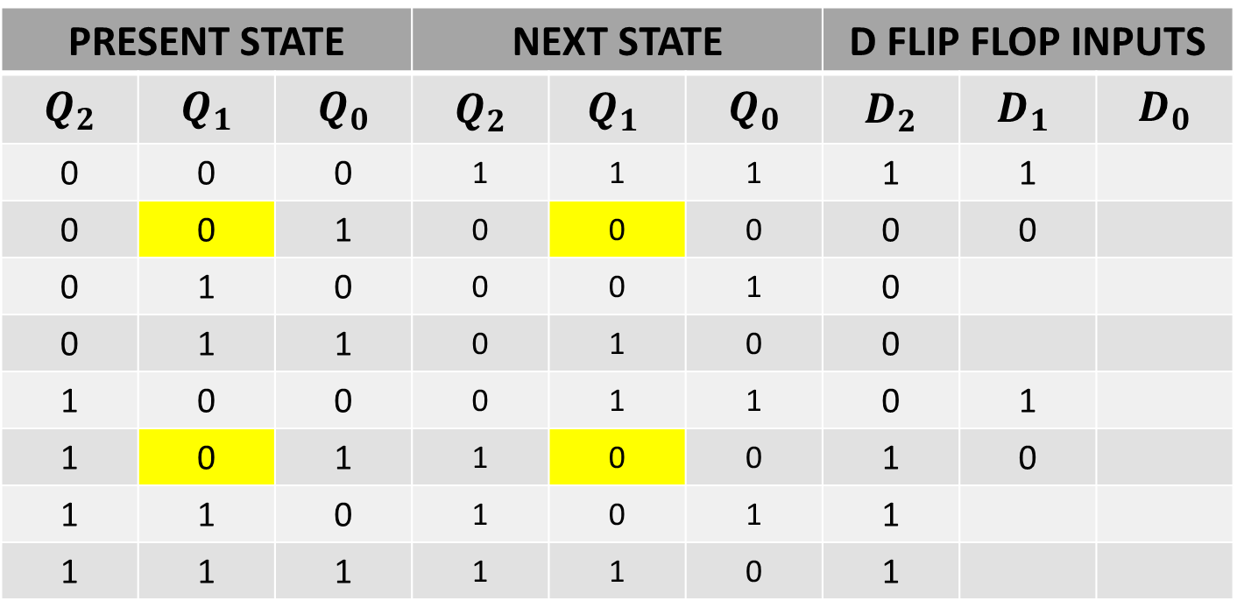
NEXT STATE TABLE USING D FLIP FLOP
$$Q_{t}$$ | $$Q_{t+1}$$ | D
0 | 0 | 0
0 | 1 | 1
1 | 0 | 0
1 | 1 | 1
PRESENT STATE |  |  | NEXT STATE |  |  | D FLIP FLOP INPUTS
$$Q_{2}$$ | $$Q_{1}$$ | $$Q_{0}$$ | $$Q_{2}$$ | $${Q_{1}}_{ }$$ | $$Q_{0}$$ | $$D_{2}$$ | $${D_{1}}_{ }$$ | $$D_{0}$$
0 | 0 | 0 | 1 | 1 | 1 | 1 | 1
0 | 0 | 1 | 0 | 0 | 0 | 0 | 0
0 | 1 | 0 | 0 | 0 | 1 | 0
0 | 1 | 1 | 0 | 1 | 0 | 0
1 | 0 | 0 | 0 | 1 | 1 | 0 | 1
1 | 0 | 1 | 1 | 0 | 0 | 1 | 0
1 | 1 | 0 | 1 | 0 | 1 | 1
1 | 1 | 1 | 1 | 1 | 0 | 1

Slide 17
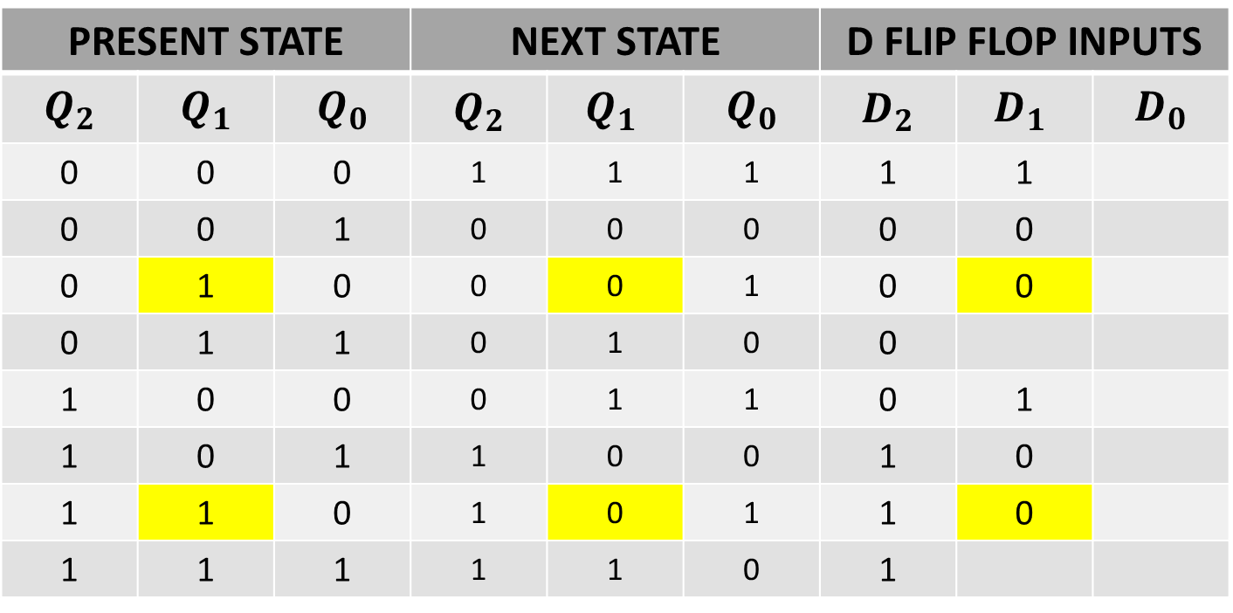
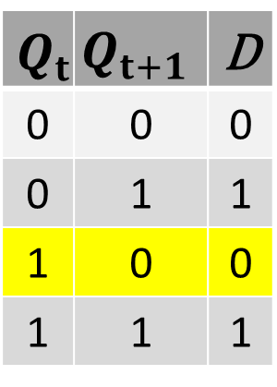
NEXT STATE TABLE USING D FLIP FLOP
$$Q_{t}$$ | $$Q_{t+1}$$ | D
0 | 0 | 0
0 | 1 | 1
1 | 0 | 0
1 | 1 | 1
PRESENT STATE |  |  | NEXT STATE |  |  | D FLIP FLOP INPUTS
$$Q_{2}$$ | $$Q_{1}$$ | $$Q_{0}$$ | $$Q_{2}$$ | $${Q_{1}}_{ }$$ | $$Q_{0}$$ | $$D_{2}$$ | $${D_{1}}_{ }$$ | $$D_{0}$$
0 | 0 | 0 | 1 | 1 | 1 | 1 | 1
0 | 0 | 1 | 0 | 0 | 0 | 0 | 0
0 | 1 | 0 | 0 | 0 | 1 | 0 | 0
0 | 1 | 1 | 0 | 1 | 0 | 0
1 | 0 | 0 | 0 | 1 | 1 | 0 | 1
1 | 0 | 1 | 1 | 0 | 0 | 1 | 0
1 | 1 | 0 | 1 | 0 | 1 | 1 | 0
1 | 1 | 1 | 1 | 1 | 0 | 1

Slide 18
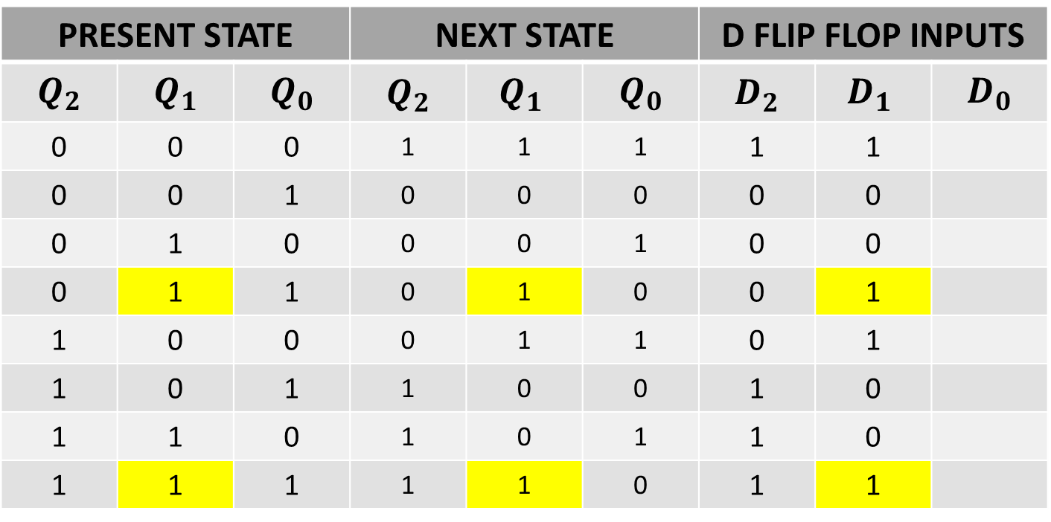

NEXT STATE TABLE USING D FLIP FLOP
$$Q_{t}$$ | $$Q_{t+1}$$ | D
0 | 0 | 0
0 | 1 | 1
1 | 0 | 0
1 | 1 | 1
PRESENT STATE |  |  | NEXT STATE |  |  | D FLIP FLOP INPUTS
$$Q_{2}$$ | $$Q_{1}$$ | $$Q_{0}$$ | $$Q_{2}$$ | $${Q_{1}}_{ }$$ | $$Q_{0}$$ | $$D_{2}$$ | $${D_{1}}_{ }$$ | $$D_{0}$$
0 | 0 | 0 | 1 | 1 | 1 | 1 | 1
0 | 0 | 1 | 0 | 0 | 0 | 0 | 0
0 | 1 | 0 | 0 | 0 | 1 | 0 | 0
0 | 1 | 1 | 0 | 1 | 0 | 0 | 1
1 | 0 | 0 | 0 | 1 | 1 | 0 | 1
1 | 0 | 1 | 1 | 0 | 0 | 1 | 0
1 | 1 | 0 | 1 | 0 | 1 | 1 | 0
1 | 1 | 1 | 1 | 1 | 0 | 1 | 1

Slide 19
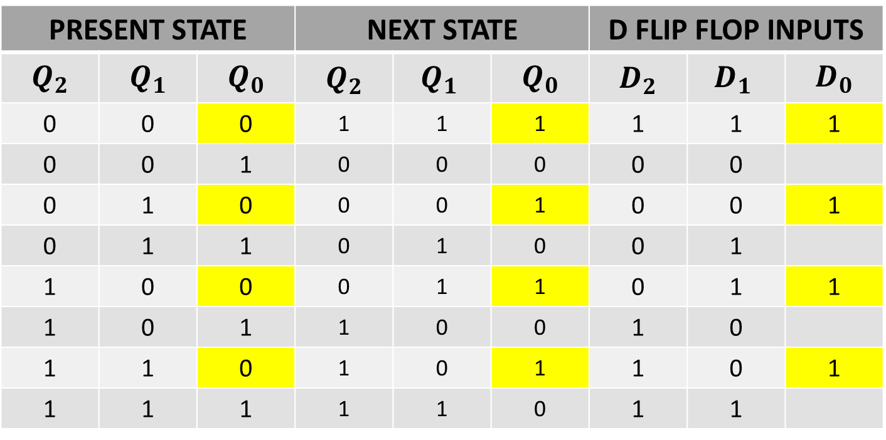
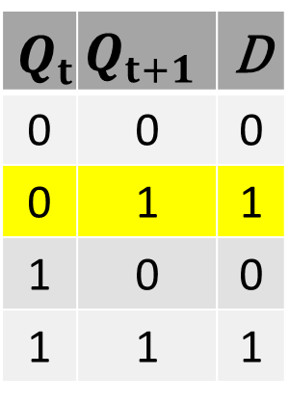
NEXT STATE TABLE USING D FLIP FLOP
$$Q_{t}$$ | $$Q_{t+1}$$ | D
0 | 0 | 0
0 | 1 | 1
1 | 0 | 0
1 | 1 | 1
PRESENT STATE |  |  | NEXT STATE |  |  | D FLIP FLOP INPUTS
$$Q_{2}$$ | $$Q_{1}$$ | $$Q_{0}$$ | $$Q_{2}$$ | $${Q_{1}}_{ }$$ | $$Q_{0}$$ | $$D_{2}$$ | $${D_{1}}_{ }$$ | $$D_{0}$$
0 | 0 | 0 | 1 | 1 | 1 | 1 | 1 | 1
0 | 0 | 1 | 0 | 0 | 0 | 0 | 0
0 | 1 | 0 | 0 | 0 | 1 | 0 | 0 | 1
0 | 1 | 1 | 0 | 1 | 0 | 0 | 1
1 | 0 | 0 | 0 | 1 | 1 | 0 | 1 | 1
1 | 0 | 1 | 1 | 0 | 0 | 1 | 0
1 | 1 | 0 | 1 | 0 | 1 | 1 | 0 | 1
1 | 1 | 1 | 1 | 1 | 0 | 1 | 1

Slide 20
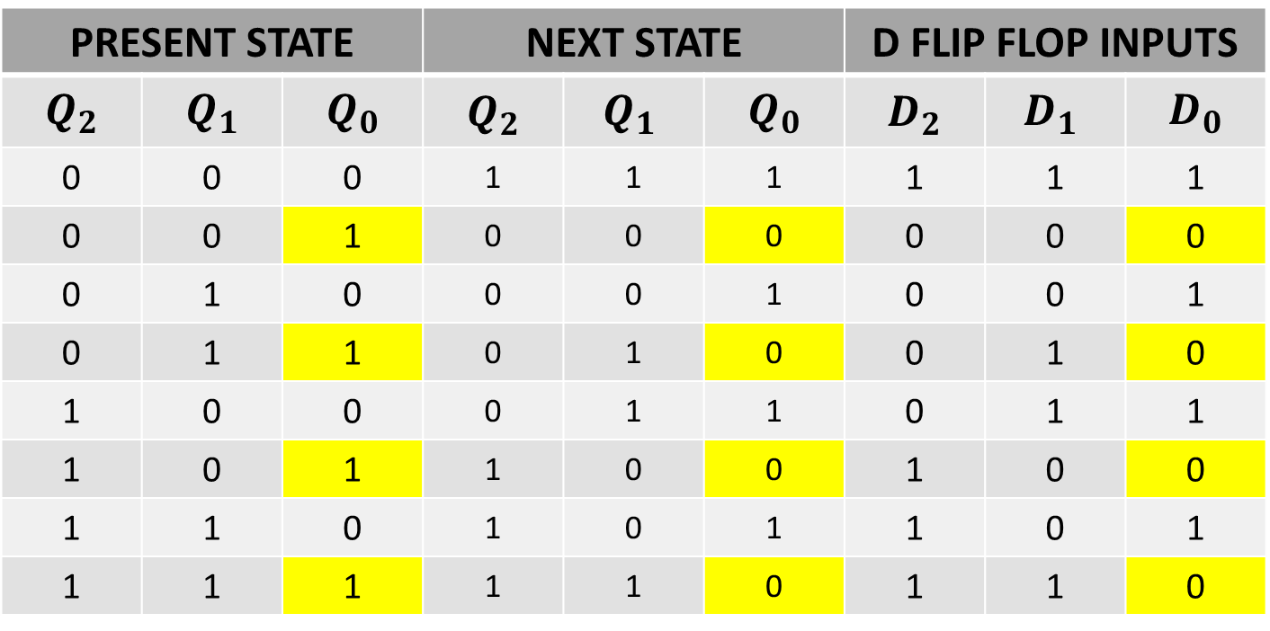
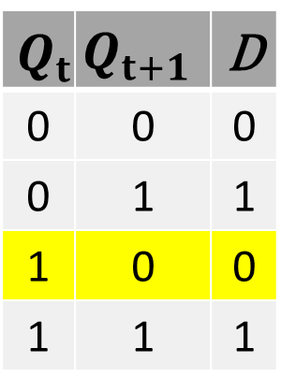
NEXT STATE TABLE USING D FLIP FLOP
$$Q_{t}$$ | $$Q_{t+1}$$ | D
0 | 0 | 0
0 | 1 | 1
1 | 0 | 0
1 | 1 | 1
PRESENT STATE |  |  | NEXT STATE |  |  | D FLIP FLOP INPUTS
$$Q_{2}$$ | $$Q_{1}$$ | $$Q_{0}$$ | $$Q_{2}$$ | $${Q_{1}}_{ }$$ | $$Q_{0}$$ | $$D_{2}$$ | $${D_{1}}_{ }$$ | $$D_{0}$$
0 | 0 | 0 | 1 | 1 | 1 | 1 | 1 | 1
0 | 0 | 1 | 0 | 0 | 0 | 0 | 0 | 0
0 | 1 | 0 | 0 | 0 | 1 | 0 | 0 | 1
0 | 1 | 1 | 0 | 1 | 0 | 0 | 1 | 0
1 | 0 | 0 | 0 | 1 | 1 | 0 | 1 | 1
1 | 0 | 1 | 1 | 0 | 0 | 1 | 0 | 0
1 | 1 | 0 | 1 | 0 | 1 | 1 | 0 | 1
1 | 1 | 1 | 1 | 1 | 0 | 1 | 1 | 0

Slide 21
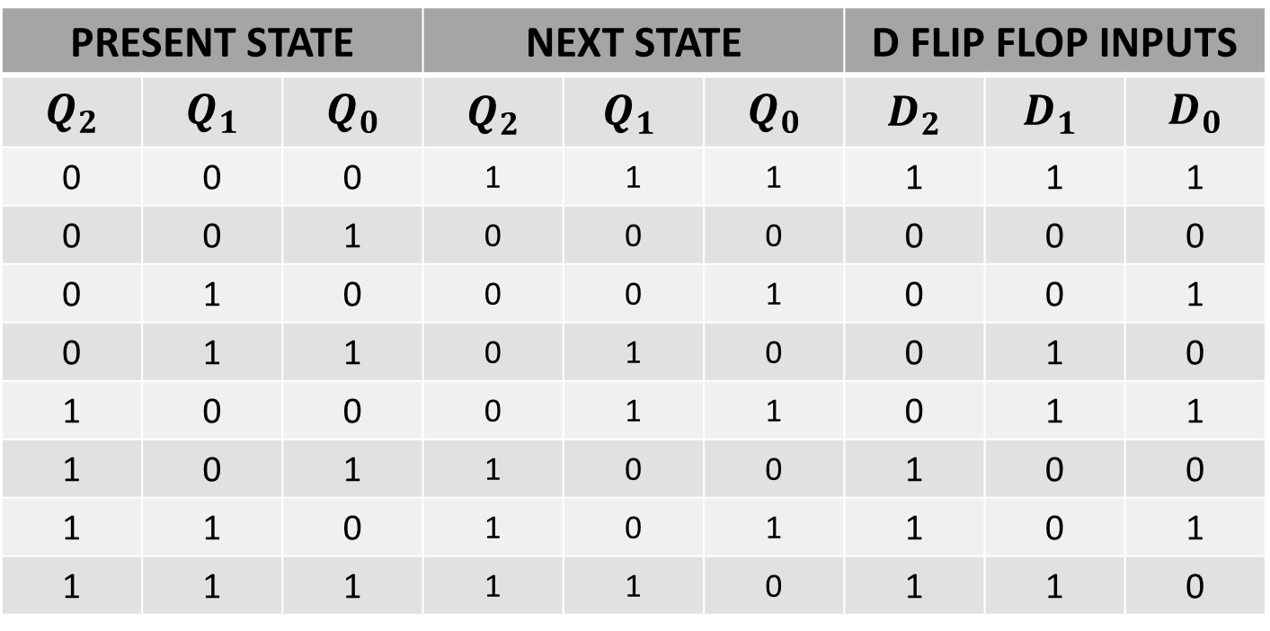
NEXT STATE TABLE USING D FLIP FLOP
PRESENT STATE |  |  | NEXT STATE |  |  | D FLIP FLOP INPUTS
$$Q_{2}$$ | $$Q_{1}$$ | $$Q_{0}$$ | $$Q_{2}$$ | $${Q_{1}}_{ }$$ | $$Q_{0}$$ | $$D_{2}$$ | $${D_{1}}_{ }$$ | $$D_{0}$$
0 | 0 | 0 | 1 | 1 | 1 | 1 | 1 | 1
0 | 0 | 1 | 0 | 0 | 0 | 0 | 0 | 0
0 | 1 | 0 | 0 | 0 | 1 | 0 | 0 | 1
0 | 1 | 1 | 0 | 1 | 0 | 0 | 1 | 0
1 | 0 | 0 | 0 | 1 | 1 | 0 | 1 | 1
1 | 0 | 1 | 1 | 0 | 0 | 1 | 0 | 0
1 | 1 | 0 | 1 | 0 | 1 | 1 | 0 | 1
1 | 1 | 1 | 1 | 1 | 0 | 1 | 1 | 0

Slide 22
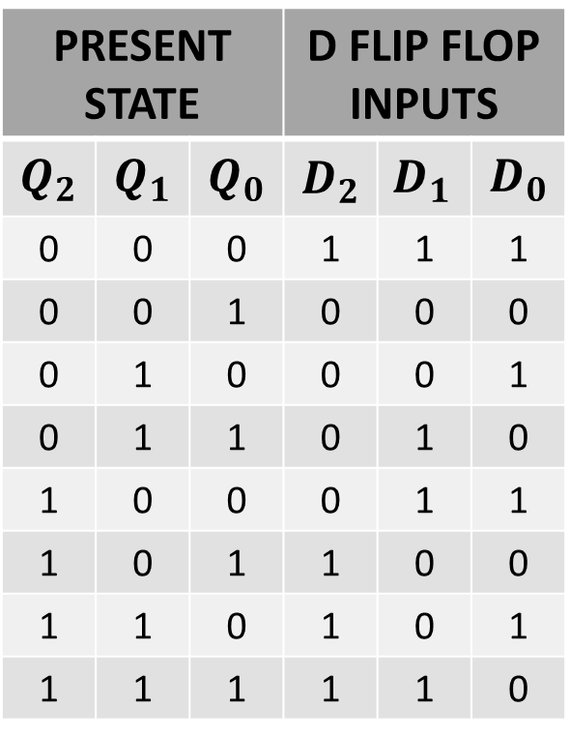
NEXT STATE TABLE USING D FLIP FLOP
PRESENT STATE |  |  | D FLIP FLOP INPUTS
$$Q_{2}$$ | $$Q_{1}$$ | $$Q_{0}$$ | $$D_{2}$$ | $${D_{1}}_{ }$$ | $$D_{0}$$
0 | 0 | 0 | 1 | 1 | 1
0 | 0 | 1 | 0 | 0 | 0
0 | 1 | 0 | 0 | 0 | 1
0 | 1 | 1 | 0 | 1 | 0
1 | 0 | 0 | 0 | 1 | 1
1 | 0 | 1 | 1 | 0 | 0
1 | 1 | 0 | 1 | 0 | 1
1 | 1 | 1 | 1 | 1 | 0

Slide 23
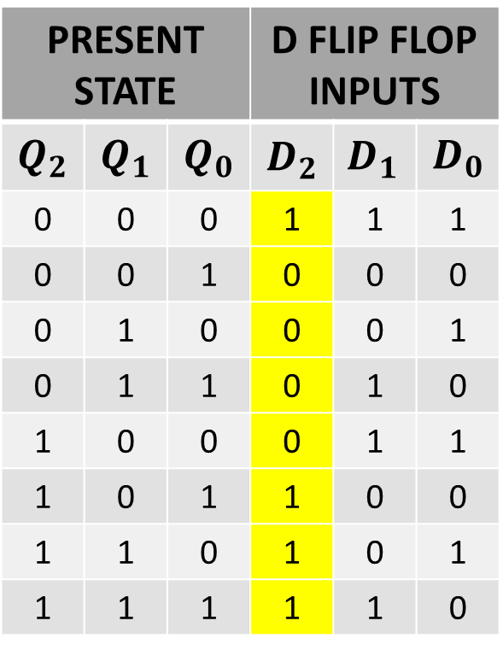
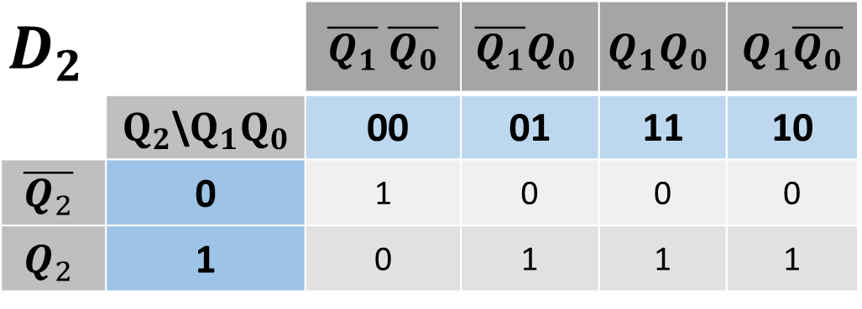
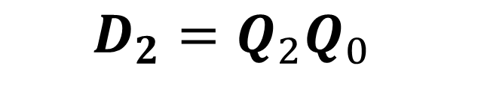
SIMPLIFICATION(K-MAP)
PRESENT STATE |  |  | D FLIP FLOP INPUTS
$$Q_{2}$$ | $$Q_{1}$$ | $$Q_{0}$$ | $$D_{2}$$ | $${D_{1}}_{ }$$ | $$D_{0}$$
0 | 0 | 0 | 1 | 1 | 1
0 | 0 | 1 | 0 | 0 | 0
0 | 1 | 0 | 0 | 0 | 1
0 | 1 | 1 | 0 | 1 | 0
1 | 0 | 0 | 0 | 1 | 1
1 | 0 | 1 | 1 | 0 | 0
1 | 1 | 0 | 1 | 0 | 1
1 | 1 | 1 | 1 | 1 | 0
$$D_{2}$$ |  | $\overline{Q_{1}}$ $\overline{Q_{0}}$ | $$\overline{Q_{1}}Q_{0}$$ | $$Q_{1}Q_{0}$$ | $Q_{1}\overline{Q_{0}}$
 | $Q_{2}$\$Q_{1}Q_{0}$ | 00 | 01 | 11 | 10
$$\overline{Q_{2}}$$ | 0 | 1 | 0 | 0 | 0
$$Q_{2}$$ | 1 | 0 | 1 | 1 | 1
$$D_{2}={Q_{2}Q}_{0 }$$

Slide 24

SIMPLIFICATION(K-MAP)
PRESENT STATE |  |  | D FLIP FLOP INPUTS
$$Q_{2}$$ | $$Q_{1}$$ | $$Q_{0}$$ | $$D_{2}$$ | $${D_{1}}_{ }$$ | $$D_{0}$$
0 | 0 | 0 | 1 | 1 | 1
0 | 0 | 1 | 0 | 0 | 0
0 | 1 | 0 | 0 | 0 | 1
0 | 1 | 1 | 0 | 1 | 0
1 | 0 | 0 | 0 | 1 | 1
1 | 0 | 1 | 1 | 0 | 0
1 | 1 | 0 | 1 | 0 | 1
1 | 1 | 1 | 1 | 1 | 0
$$D_{2}$$ |  | $\overline{Q_{1}}$ $\overline{Q_{0}}$ | $$\overline{Q_{1}}Q_{0}$$ | $$Q_{1}Q_{0}$$ | $Q_{1}\overline{Q_{0}}$
 | $Q_{2}$\$Q_{1}Q_{0}$ | 00 | 01 | 11 | 10
$$\overline{Q_{2}}$$ | 0 | 1 | 0 | 0 | 0
$$Q_{2}$$ | 1 | 0 | 1 | 1 | 1
$$D_{2}={Q_{2}Q}_{0}+{Q_{2}Q}_{1 }$$

Slide 25
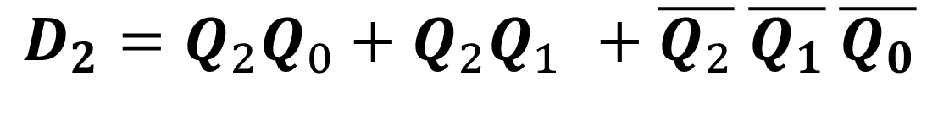
SIMPLIFICATION(K-MAP)
PRESENT STATE |  |  | D FLIP FLOP INPUTS
$$Q_{2}$$ | $$Q_{1}$$ | $$Q_{0}$$ | $$D_{2}$$ | $${D_{1}}_{ }$$ | $$D_{0}$$
0 | 0 | 0 | 1 | 1 | 1
0 | 0 | 1 | 0 | 0 | 0
0 | 1 | 0 | 0 | 0 | 1
0 | 1 | 1 | 0 | 1 | 0
1 | 0 | 0 | 0 | 1 | 1
1 | 0 | 1 | 1 | 0 | 0
1 | 1 | 0 | 1 | 0 | 1
1 | 1 | 1 | 1 | 1 | 0
$$D_{2}$$ |  | $\overline{Q_{1}}$ $\overline{Q_{0}}$ | $$\overline{Q_{1}}Q_{0}$$ | $$Q_{1}Q_{0}$$ | $Q_{1}\overline{Q_{0}}$
 | $Q_{2}$\$Q_{1}Q_{0}$ | 00 | 01 | 11 | 10
$$\overline{Q_{2}}$$ | 0 | 1 | 0 | 0 | 0
$$Q_{2}$$ | 1 | 0 | 1 | 1 | 1
$$D_{2}={Q_{2}Q}_{0}+{Q_{2}Q}_{1 }+\overline{Q_{2}} \overline{Q_{1}} \overline{Q_{0}}$$

Slide 26
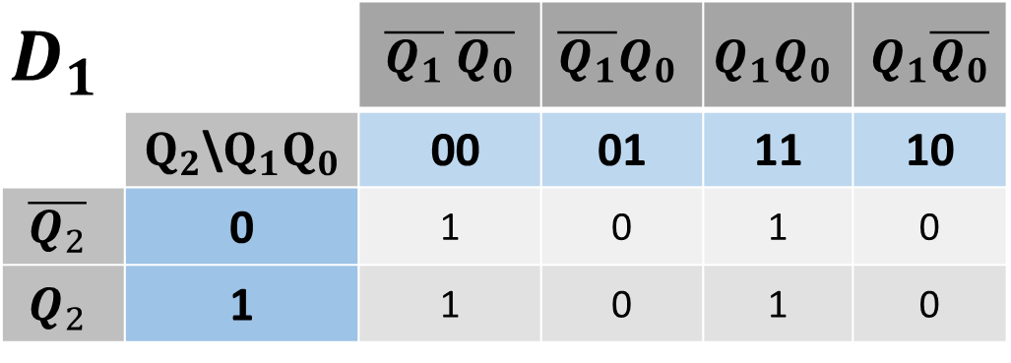
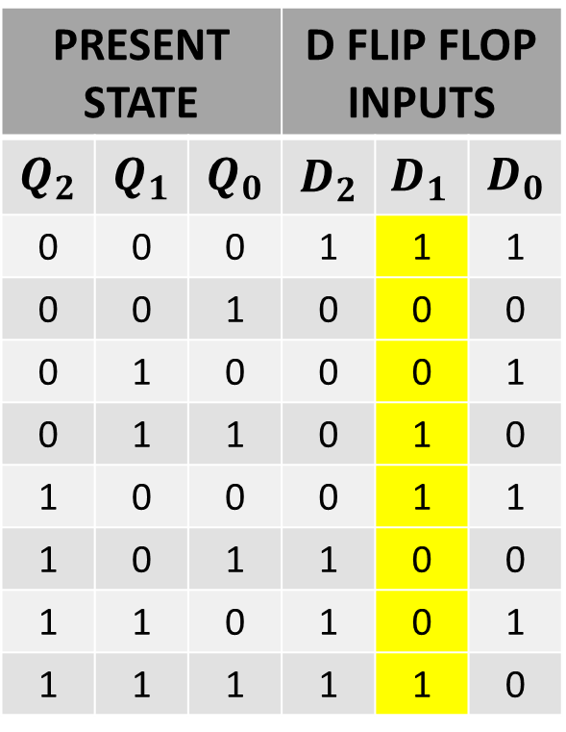

SIMPLIFICATION(K-MAP)
PRESENT STATE |  |  | D FLIP FLOP INPUTS
$$Q_{2}$$ | $$Q_{1}$$ | $$Q_{0}$$ | $$D_{2}$$ | $${D_{1}}_{ }$$ | $$D_{0}$$
0 | 0 | 0 | 1 | 1 | 1
0 | 0 | 1 | 0 | 0 | 0
0 | 1 | 0 | 0 | 0 | 1
0 | 1 | 1 | 0 | 1 | 0
1 | 0 | 0 | 0 | 1 | 1
1 | 0 | 1 | 1 | 0 | 0
1 | 1 | 0 | 1 | 0 | 1
1 | 1 | 1 | 1 | 1 | 0
$$D_{1}$$ |  | $\overline{Q_{1}}$ $\overline{Q_{0}}$ | $$\overline{Q_{1}}Q_{0}$$ | $$Q_{1}Q_{0}$$ | $Q_{1}\overline{Q_{0}}$
 | $Q_{2}$\$Q_{1}Q_{0}$ | 00 | 01 | 11 | 10
$$\overline{Q_{2}}$$ | 0 | 1 | 0 | 1 | 0
$$Q_{2}$$ | 1 | 1 | 0 | 1 | 0
$$D_{1}=\overline{Q_{1}} \overline{Q_{0}}$$

Slide 27

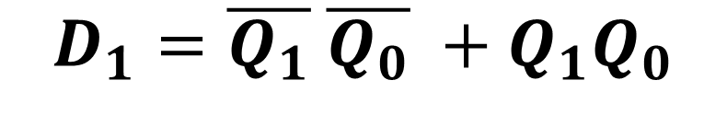

SIMPLIFICATION(K-MAP)
PRESENT STATE |  |  | D FLIP FLOP INPUTS
$$Q_{2}$$ | $$Q_{1}$$ | $$Q_{0}$$ | $$D_{2}$$ | $${D_{1}}_{ }$$ | $$D_{0}$$
0 | 0 | 0 | 1 | 1 | 1
0 | 0 | 1 | 0 | 0 | 0
0 | 1 | 0 | 0 | 0 | 1
0 | 1 | 1 | 0 | 1 | 0
1 | 0 | 0 | 0 | 1 | 1
1 | 0 | 1 | 1 | 0 | 0
1 | 1 | 0 | 1 | 0 | 1
1 | 1 | 1 | 1 | 1 | 0
$$D_{1}$$ |  | $\overline{Q_{1}}$ $\overline{Q_{0}}$ | $$\overline{Q_{1}}Q_{0}$$ | $$Q_{1}Q_{0}$$ | $Q_{1}\overline{Q_{0}}$
 | $Q_{2}$\$Q_{1}Q_{0}$ | 00 | 01 | 11 | 10
$$\overline{Q_{2}}$$ | 0 | 1 | 0 | 1 | 0
$$Q_{2}$$ | 1 | 1 | 0 | 1 | 0
$$D_{1}=\overline{Q_{1}} \overline{Q_{0}} +Q_{1}Q_{0}$$
$$D_{1}=\overline{Q_{0} ⨁{ Q}_{1}}$$

Slide 28

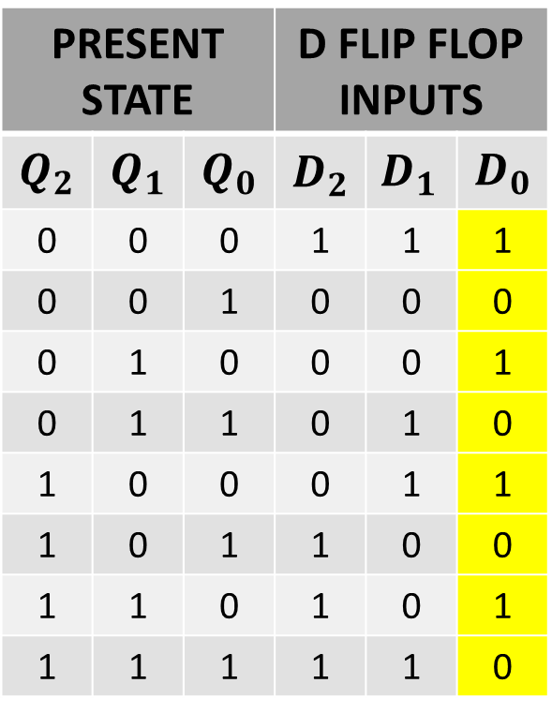
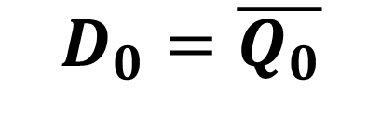
SIMPLIFICATION(K-MAP)
PRESENT STATE |  |  | D FLIP FLOP INPUTS
$$Q_{2}$$ | $$Q_{1}$$ | $$Q_{0}$$ | $$D_{2}$$ | $${D_{1}}_{ }$$ | $$D_{0}$$
0 | 0 | 0 | 1 | 1 | 1
0 | 0 | 1 | 0 | 0 | 0
0 | 1 | 0 | 0 | 0 | 1
0 | 1 | 1 | 0 | 1 | 0
1 | 0 | 0 | 0 | 1 | 1
1 | 0 | 1 | 1 | 0 | 0
1 | 1 | 0 | 1 | 0 | 1
1 | 1 | 1 | 1 | 1 | 0
$$D_{0}$$ |  | $\overline{Q_{1}}$ $\overline{Q_{0}}$ | $$\overline{Q_{1}}Q_{0}$$ | $$Q_{1}Q_{0}$$ | $Q_{1}\overline{Q_{0}}$
 | $Q_{2}$\$Q_{1}Q_{0}$ | 00 | 01 | 11 | 10
$$\overline{Q_{2}}$$ | 0 | 1 | 0 | 0 | 1
$$Q_{2}$$ | 1 | 1 | 0 | 0 | 1
$$D_{0}=\overline{Q_{0}}$$

Slide 29
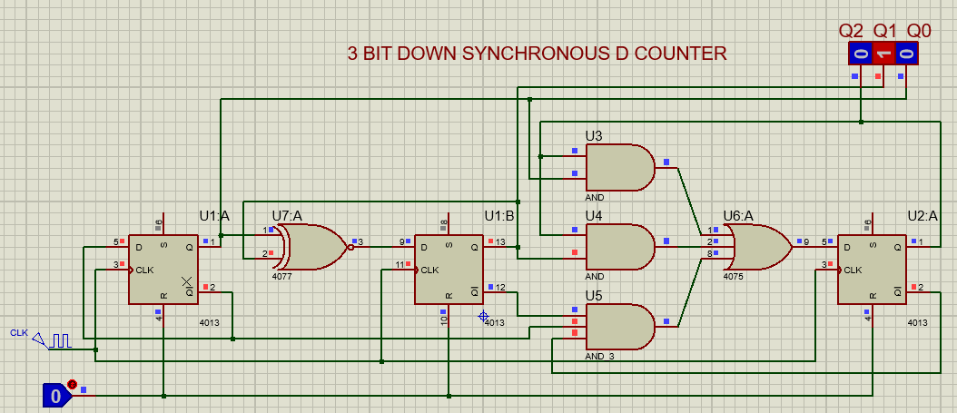
IMPLEMENTATIONS OF EQUATION

Slide 30
NEXT STATE TABLE USING JK FLIP FLOP
PRESENT STATE |  |  | NEXT STATE
$$Q_{2}$$ | $$Q_{1}$$ | $$Q_{0}$$ | $$Q_{2}$$ | $${Q_{1}}_{ }$$ | $$Q_{0}$$
0 | 0 | 0 | 1 | 1 | 1
0 | 0 | 1 | 0 | 0 | 0
0 | 1 | 0 | 0 | 0 | 1
0 | 1 | 1 | 0 | 1 | 0
1 | 0 | 0 | 0 | 1 | 1
1 | 0 | 1 | 1 | 0 | 0
1 | 1 | 0 | 1 | 0 | 1
1 | 1 | 1 | 1 | 1 | 0

Slide 31
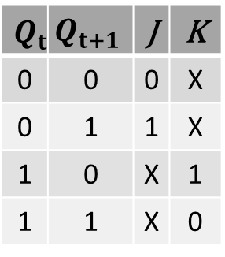
NEXT STATE TABLE USING JK FLIP FLOP
$$Q_{t}$$ | $$Q_{t+1}$$ | J | K
0 | 0 | 0 | X
0 | 1 | 1 | X
1 | 0 | X | 1
1 | 1 | X | 0
PRESENT STATE |  |  | NEXT STATE
$$Q_{2}$$ | $$Q_{1}$$ | $$Q_{0}$$ | $$Q_{2}$$ | $${Q_{1}}_{ }$$ | $$Q_{0}$$
0 | 0 | 0 | 1 | 1 | 1
0 | 0 | 1 | 0 | 0 | 0
0 | 1 | 0 | 0 | 0 | 1
0 | 1 | 1 | 0 | 1 | 0
1 | 0 | 0 | 0 | 1 | 1
1 | 0 | 1 | 1 | 0 | 0
1 | 1 | 0 | 1 | 0 | 1
1 | 1 | 1 | 1 | 1 | 0

Slide 32
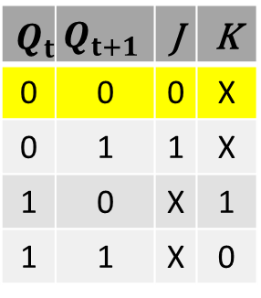
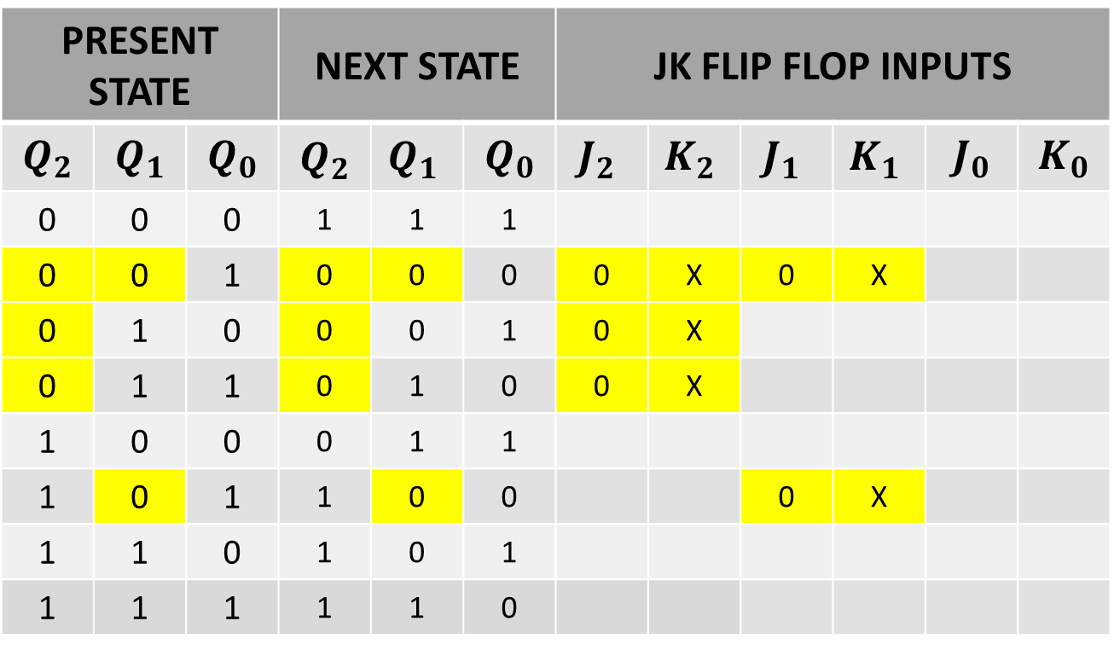
NEXT STATE TABLE USING JK FLIP FLOP
$$Q_{t}$$ | $$Q_{t+1}$$ | J | K
0 | 0 | 0 | X
0 | 1 | 1 | X
1 | 0 | X | 1
1 | 1 | X | 0
PRESENT STATE |  |  | NEXT STATE |  |  | JK FLIP FLOP INPUTS
$$Q_{2}$$ | $$Q_{1}$$ | $$Q_{0}$$ | $$Q_{2}$$ | $${Q_{1}}_{ }$$ | $$Q_{0}$$ | $${J_{2}}_{ }$$ | $${K_{2}}_{ }$$ | $${J_{1}}_{ }$$ | $${K_{1}}_{ }$$ | $$J_{0}$$ | $$K_{0}$$
0 | 0 | 0 | 1 | 1 | 1
0 | 0 | 1 | 0 | 0 | 0 | 0 | X | 0 | X
0 | 1 | 0 | 0 | 0 | 1 | 0 | X
0 | 1 | 1 | 0 | 1 | 0 | 0 | X
1 | 0 | 0 | 0 | 1 | 1
1 | 0 | 1 | 1 | 0 | 0 |  |  | 0 | X
1 | 1 | 0 | 1 | 0 | 1
1 | 1 | 1 | 1 | 1 | 0

Slide 33
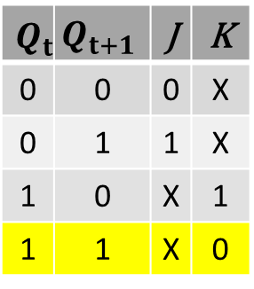

NEXT STATE TABLE USING JK FLIP FLOP
$$Q_{t}$$ | $$Q_{t+1}$$ | J | K
0 | 0 | 0 | X
0 | 1 | 1 | X
1 | 0 | X | 1
1 | 1 | X | 0
PRESENT STATE |  |  | NEXT STATE |  |  | JK FLIP FLOP INPUTS
$$Q_{2}$$ | $$Q_{1}$$ | $$Q_{0}$$ | $$Q_{2}$$ | $${Q_{1}}_{ }$$ | $$Q_{0}$$ | $${J_{2}}_{ }$$ | $${K_{2}}_{ }$$ | $${J_{1}}_{ }$$ | $${K_{1}}_{ }$$ | $$J_{0}$$ | $$K_{0}$$
0 | 0 | 0 | 1 | 1 | 1
0 | 0 | 1 | 0 | 0 | 0 | 0 | X | 0 | X
0 | 1 | 0 | 0 | 0 | 1 | 0 | X
0 | 1 | 1 | 0 | 1 | 0 | 0 | X | X | 0
1 | 0 | 0 | 0 | 1 | 1
1 | 0 | 1 | 1 | 0 | 0 | X | 0 | 0 | X
1 | 1 | 0 | 1 | 0 | 1 | X | 0
1 | 1 | 1 | 1 | 1 | 0 | X | 0 | X | 0

Slide 34


NEXT STATE TABLE USING JK FLIP FLOP
$$Q_{t}$$ | $$Q_{t+1}$$ | J | K
0 | 0 | 0 | X
0 | 1 | 1 | X
1 | 0 | X | 1
1 | 1 | X | 0
PRESENT STATE |  |  | NEXT STATE |  |  | JK FLIP FLOP INPUTS
$$Q_{2}$$ | $$Q_{1}$$ | $$Q_{0}$$ | $$Q_{2}$$ | $${Q_{1}}_{ }$$ | $$Q_{0}$$ | $${J_{2}}_{ }$$ | $${K_{2}}_{ }$$ | $${J_{1}}_{ }$$ | $${K_{1}}_{ }$$ | $$J_{0}$$ | $$K_{0}$$
0 | 0 | 0 | 1 | 1 | 1 | 1 | X | 1 | X | 1 | X
0 | 0 | 1 | 0 | 0 | 0 | 0 | X | 0 | X
0 | 1 | 0 | 0 | 0 | 1 | 0 | X |  |  | 1 | X
0 | 1 | 1 | 0 | 1 | 0 | 0 | X | X | 0
1 | 0 | 0 | 0 | 1 | 1 |  |  | 1 | X | 1 | X
1 | 0 | 1 | 1 | 0 | 0 | X | 0 | 0 | X
1 | 1 | 0 | 1 | 0 | 1 | X | 0 |  |  | 1 | X
1 | 1 | 1 | 1 | 1 | 0 | X | 0 | X | 0

Slide 35


NEXT STATE TABLE USING JK FLIP FLOP
$$Q_{t}$$ | $$Q_{t+1}$$ | J | K
0 | 0 | 0 | X
0 | 1 | 1 | X
1 | 0 | X | 1
1 | 1 | X | 0
PRESENT STATE |  |  | NEXT STATE |  |  | JK FLIP FLOP INPUTS
$$Q_{2}$$ | $$Q_{1}$$ | $$Q_{0}$$ | $$Q_{2}$$ | $${Q_{1}}_{ }$$ | $$Q_{0}$$ | $${J_{2}}_{ }$$ | $${K_{2}}_{ }$$ | $${J_{1}}_{ }$$ | $${K_{1}}_{ }$$ | $$J_{0}$$ | $$K_{0}$$
0 | 0 | 0 | 1 | 1 | 1 | 1 | X | 1 | X | 1 | X
0 | 0 | 1 | 0 | 0 | 0 | 0 | X | 0 | X | X | 1
0 | 1 | 0 | 0 | 0 | 1 | 0 | X | X | 1 | 1 | X
0 | 1 | 1 | 0 | 1 | 0 | 0 | X | X | 0 | X | 1
1 | 0 | 0 | 0 | 1 | 1 | X | 1 | 1 | X | 1 | X
1 | 0 | 1 | 1 | 0 | 0 | X | 0 | 0 | X | X | 1
1 | 1 | 0 | 1 | 0 | 1 | X | 0 | X | 1 | 1 | X
1 | 1 | 1 | 1 | 1 | 0 | X | 0 | X | 0 | X | 1

Slide 36


NEXT STATE TABLE USING JK FLIP FLOP
$$Q_{t}$$ | $$Q_{t+1}$$ | J | K
0 | 0 | 0 | X
0 | 1 | 1 | X
1 | 0 | X | 1
1 | 1 | X | 0
PRESENT STATE |  |  | NEXT STATE |  |  | JK FLIP FLOP INPUTS
$$Q_{2}$$ | $$Q_{1}$$ | $$Q_{0}$$ | $$Q_{2}$$ | $${Q_{1}}_{ }$$ | $$Q_{0}$$ | $${J_{2}}_{ }$$ | $${K_{2}}_{ }$$ | $${J_{1}}_{ }$$ | $${K_{1}}_{ }$$ | $$J_{0}$$ | $$K_{0}$$
0 | 0 | 0 | 1 | 1 | 1 | 1 | X | 1 | X | 1 | X
0 | 0 | 1 | 0 | 0 | 0 | 0 | X | 0 | X | X | 1
0 | 1 | 0 | 0 | 0 | 1 | 0 | X | X | 1 | 1 | X
0 | 1 | 1 | 0 | 1 | 0 | 0 | X | X | 0 | X | 1
1 | 0 | 0 | 0 | 1 | 1 | X | 1 | 1 | X | 1 | X
1 | 0 | 1 | 1 | 0 | 0 | X | 0 | 0 | X | X | 1
1 | 1 | 0 | 1 | 0 | 1 | X | 0 | X | 1 | 1 | X
1 | 1 | 1 | 1 | 1 | 0 | X | 0 | X | 0 | X | 1

Slide 37

NEXT STATE TABLE USING JK FLIP FLOP FOR FF1
PRESENT STATE |  |  | JK FLIP FLOP INPUTS
$$Q_{2}$$ | $$Q_{1}$$ | $$Q_{0}$$ | $${J_{2}}_{ }$$ | $${K_{2}}_{ }$$ | $${J_{1}}_{ }$$ | $${K_{1}}_{ }$$ | $$J_{0}$$ | $$K_{0}$$
0 | 0 | 0 | 1 | X | 1 | X | 1 | X
0 | 0 | 1 | 0 | X | 0 | X | X | 1
0 | 1 | 0 | 0 | X | X | 1 | 1 | X
0 | 1 | 1 | 0 | X | X | 0 | X | 1
1 | 0 | 0 | X | 1 | 1 | X | 1 | X
1 | 0 | 1 | X | 0 | 0 | X | X | 1
1 | 1 | 0 | X | 0 | X | 1 | 1 | X
1 | 1 | 1 | X | 0 | X | 0 | X | 1

Slide 38



SIMPLIFICATION(K-MAP)
PRESENT STATE |  |  | JK FLIP FLOP INPUTS
$$Q_{2}$$ | $$Q_{1}$$ | $$Q_{0}$$ | $${J_{2}}_{ }$$ | $${K_{2}}_{ }$$ | $${J_{1}}_{ }$$ | $${K_{1}}_{ }$$ | $$J_{0}$$ | $$K_{0}$$
0 | 0 | 0 | 1 | X | 1 | X | 1 | X
0 | 0 | 1 | 0 | X | 0 | X | X | 1
0 | 1 | 0 | 0 | X | X | 1 | 1 | X
0 | 1 | 1 | 0 | X | X | 0 | X | 1
1 | 0 | 0 | X | 1 | 1 | X | 1 | X
1 | 0 | 1 | X | 0 | 0 | X | X | 1
1 | 1 | 0 | X | 0 | X | 1 | 1 | X
1 | 1 | 1 | X | 0 | X | 0 | X | 1
$$J_{2}$$ |  | $\overline{Q_{1}}$ $\overline{Q_{0}}$ | $$\overline{Q_{1}}Q_{0}$$ | $$Q_{1}Q_{0}$$ | $Q_{1}\overline{Q_{0}}$
 | $Q_{2}$\$Q_{1}Q_{0}$ | 00 | 01 | 11 | 10
$$\overline{Q_{2}}$$ | 0 | 1 | 0 | 0 | 0
$$Q_{2}$$ | 1 | X | X | X | X
$$J_{2}=\overline{Q_{1}} \overline{Q_{0}}$$

Slide 39



SIMPLIFICATION(K-MAP)
PRESENT STATE |  |  | JK FLIP FLOP INPUTS
$$Q_{2}$$ | $$Q_{1}$$ | $$Q_{0}$$ | $${J_{2}}_{ }$$ | $${K_{2}}_{ }$$ | $${J_{1}}_{ }$$ | $${K_{1}}_{ }$$ | $$J_{0}$$ | $$K_{0}$$
0 | 0 | 0 | 1 | X | 1 | X | 1 | X
0 | 0 | 1 | 0 | X | 0 | X | X | 1
0 | 1 | 0 | 0 | X | X | 1 | 1 | X
0 | 1 | 1 | 0 | X | X | 0 | X | 1
1 | 0 | 0 | X | 1 | 1 | X | 1 | X
1 | 0 | 1 | X | 0 | 0 | X | X | 1
1 | 1 | 0 | X | 0 | X | 1 | 1 | X
1 | 1 | 1 | X | 0 | X | 0 | X | 1
$$K_{2}$$ |  | $\overline{Q_{1}}$ $\overline{Q_{0}}$ | $$\overline{Q_{1}}Q_{0}$$ | $$Q_{1}Q_{0}$$ | $Q_{1}\overline{Q_{0}}$
 | $Q_{2}$\$Q_{1}Q_{0}$ | 00 | 01 | 11 | 10
$$\overline{Q_{2}}$$ | 0 | X | X | X | X
$$Q_{2}$$ | 1 | 1 | 0 | 0 | 0
$$K_{2}=\overline{Q_{1}} \overline{Q_{0}}$$

Slide 40



SIMPLIFICATION(K-MAP)
PRESENT STATE |  |  | JK FLIP FLOP INPUTS
$$Q_{2}$$ | $$Q_{1}$$ | $$Q_{0}$$ | $${J_{2}}_{ }$$ | $${K_{2}}_{ }$$ | $${J_{1}}_{ }$$ | $${K_{1}}_{ }$$ | $$J_{0}$$ | $$K_{0}$$
0 | 0 | 0 | 1 | X | 1 | X | 1 | X
0 | 0 | 1 | 0 | X | 0 | X | X | 1
0 | 1 | 0 | 0 | X | X | 1 | 1 | X
0 | 1 | 1 | 0 | X | X | 0 | X | 1
1 | 0 | 0 | X | 1 | 1 | X | 1 | X
1 | 0 | 1 | X | 0 | 0 | X | X | 1
1 | 1 | 0 | X | 0 | X | 1 | 1 | X
1 | 1 | 1 | X | 0 | X | 0 | X | 1
$$J_{1}$$ |  | $\overline{Q_{1}}$ $\overline{Q_{0}}$ | $$\overline{Q_{1}}Q_{0}$$ | $$Q_{1}Q_{0}$$ | $Q_{1}\overline{Q_{0}}$
 | $Q_{2}$\$Q_{1}Q_{0}$ | 00 | 01 | 11 | 10
$$\overline{Q_{2}}$$ | 0 | 1 | 0 | X | X
$$Q_{2}$$ | 1 | 1 | 0 | X | X
$$J_{1}=\overline{Q_{0}}$$

Slide 41



SIMPLIFICATION(K-MAP)
PRESENT STATE |  |  | JK FLIP FLOP INPUTS
$$Q_{2}$$ | $$Q_{1}$$ | $$Q_{0}$$ | $${J_{2}}_{ }$$ | $${K_{2}}_{ }$$ | $${J_{1}}_{ }$$ | $${K_{1}}_{ }$$ | $$J_{0}$$ | $$K_{0}$$
0 | 0 | 0 | 1 | X | 1 | X | 1 | X
0 | 0 | 1 | 0 | X | 0 | X | X | 1
0 | 1 | 0 | 0 | X | X | 1 | 1 | X
0 | 1 | 1 | 0 | X | X | 0 | X | 1
1 | 0 | 0 | X | 1 | 1 | X | 1 | X
1 | 0 | 1 | X | 0 | 0 | X | X | 1
1 | 1 | 0 | X | 0 | X | 1 | 1 | X
1 | 1 | 1 | X | 0 | X | 0 | X | 1
$$K_{1}$$ |  | $\overline{Q_{1}}$ $\overline{Q_{0}}$ | $$\overline{Q_{1}}Q_{0}$$ | $$Q_{1}Q_{0}$$ | $Q_{1}\overline{Q_{0}}$
 | $Q_{2}$\$Q_{1}Q_{0}$ | 00 | 01 | 11 | 10
$$\overline{Q_{2}}$$ | 0 | X | X | 0 | 1
$$Q_{2}$$ | 1 | X | X | 0 | 1
$$K_{1}=\overline{Q_{0}}$$

Slide 42



SIMPLIFICATION(K-MAP)
PRESENT STATE |  |  | JK FLIP FLOP INPUTS
$$Q_{2}$$ | $$Q_{1}$$ | $$Q_{0}$$ | $${J_{2}}_{ }$$ | $${K_{2}}_{ }$$ | $${J_{1}}_{ }$$ | $${K_{1}}_{ }$$ | $$J_{0}$$ | $$K_{0}$$
0 | 0 | 0 | 1 | X | 1 | X | 1 | X
0 | 0 | 1 | 0 | X | 0 | X | X | 1
0 | 1 | 0 | 0 | X | X | 1 | 1 | X
0 | 1 | 1 | 0 | X | X | 0 | X | 1
1 | 0 | 0 | X | 1 | 1 | X | 1 | X
1 | 0 | 1 | X | 0 | 0 | X | X | 1
1 | 1 | 0 | X | 0 | X | 1 | 1 | X
1 | 1 | 1 | X | 0 | X | 0 | X | 1
$$J_{0}$$ |  | $\overline{Q_{1}}$ $\overline{Q_{0}}$ | $$\overline{Q_{1}}Q_{0}$$ | $$Q_{1}Q_{0}$$ | $Q_{1}\overline{Q_{0}}$
 | $Q_{2}$\$Q_{1}Q_{0}$ | 00 | 01 | 11 | 10
$$\overline{Q_{2}}$$ | 0 | 1 | X | X | 1
$$Q_{2}$$ | 1 | 1 | X | X | 1
$$J_{0}=1$$

Slide 43



SIMPLIFICATION(K-MAP)
PRESENT STATE |  |  | JK FLIP FLOP INPUTS
$$Q_{2}$$ | $$Q_{1}$$ | $$Q_{0}$$ | $${J_{2}}_{ }$$ | $${K_{2}}_{ }$$ | $${J_{1}}_{ }$$ | $${K_{1}}_{ }$$ | $$J_{0}$$ | $$K_{0}$$
0 | 0 | 0 | 1 | X | 1 | X | 1 | X
0 | 0 | 1 | 0 | X | 0 | X | X | 1
0 | 1 | 0 | 0 | X | X | 1 | 1 | X
0 | 1 | 1 | 0 | X | X | 0 | X | 1
1 | 0 | 0 | X | 1 | 1 | X | 1 | X
1 | 0 | 1 | X | 0 | 0 | X | X | 1
1 | 1 | 0 | X | 0 | X | 1 | 1 | X
1 | 1 | 1 | X | 0 | X | 0 | X | 1
$$K_{0}$$ |  | $\overline{Q_{1}}$ $\overline{Q_{0}}$ | $$\overline{Q_{1}}Q_{0}$$ | $$Q_{1}Q_{0}$$ | $Q_{1}\overline{Q_{0}}$
 | $Q_{2}$\$Q_{1}Q_{0}$ | 00 | 01 | 11 | 10
$$\overline{Q_{2}}$$ | 0 | X | 1 | 1 | X
$$Q_{2}$$ | 1 | X | 1 | 1 | X
$$K_{0}=1$$

Slide 44






INPUT EQUATIONS
$$J_{2}=\overline{Q_{1}} \overline{Q_{0}}$$
$$K_{2}=\overline{Q_{1}} \overline{Q_{0}}$$
$$J_{1}=\overline{Q_{0}}$$
$$K_{1}=\overline{Q_{0}}$$
$$J_{0}=1$$
$$K_{0}=1$$

Slide 45

IMPLEMENTATIONS OF EQUATION

